Slide 1

Boosting Traffic with Data: Predicting Popular Recipes for Tasty Bytes
A Data-Driven Approach to Recipe Recommendations by Khai Kieu

Slide 2
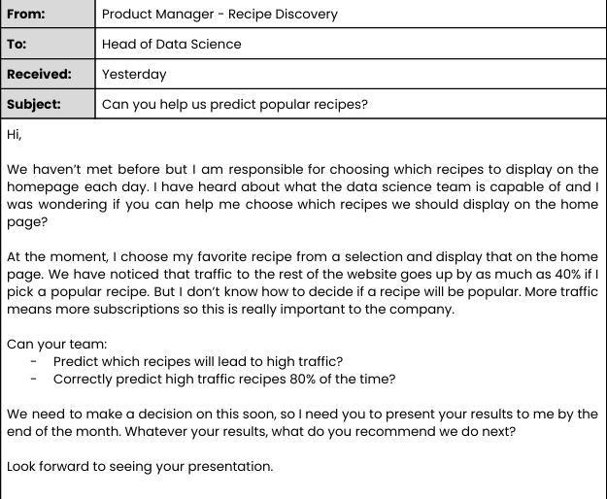
Problems & goals
Our problems: Missed revenue when unpopular recipes are featured
Manual recipe selection results in inconsistent traffic
Our goals:
Predict high-traffic recipes with ≥80% precision
The challenge?
The product team needs a reliable way to identify recipes that drive traffic.
Client's email:

Slide 3
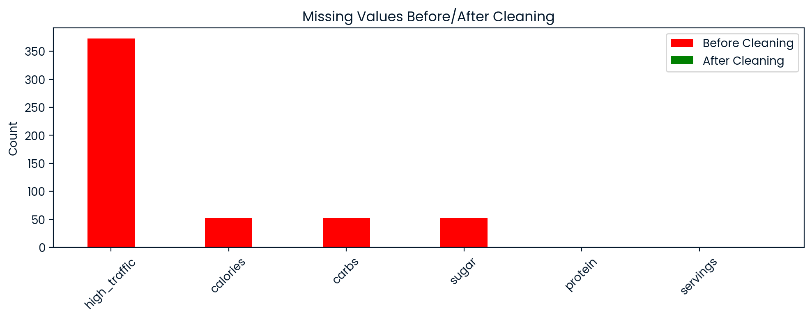
Data cleaning
Fixed missing high_traffic values (50% were not assigned
Imputed calories, protein with medians
Cleaned servings

Slide 4
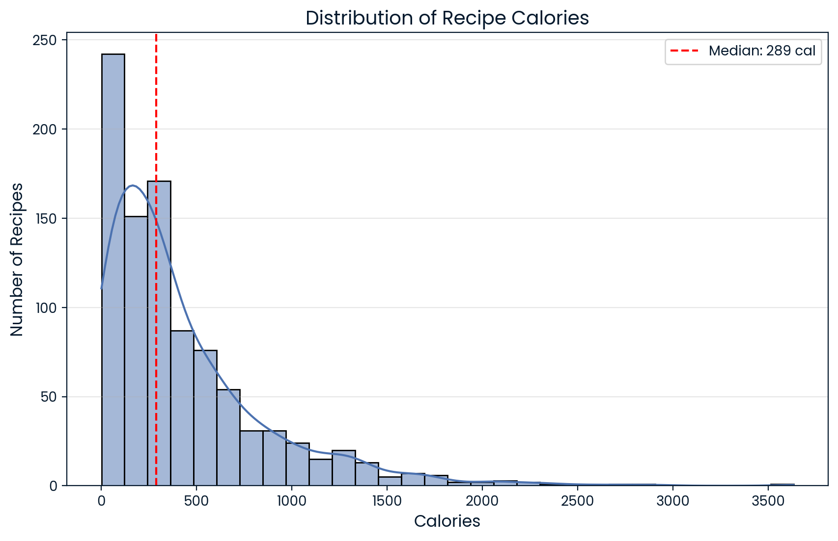
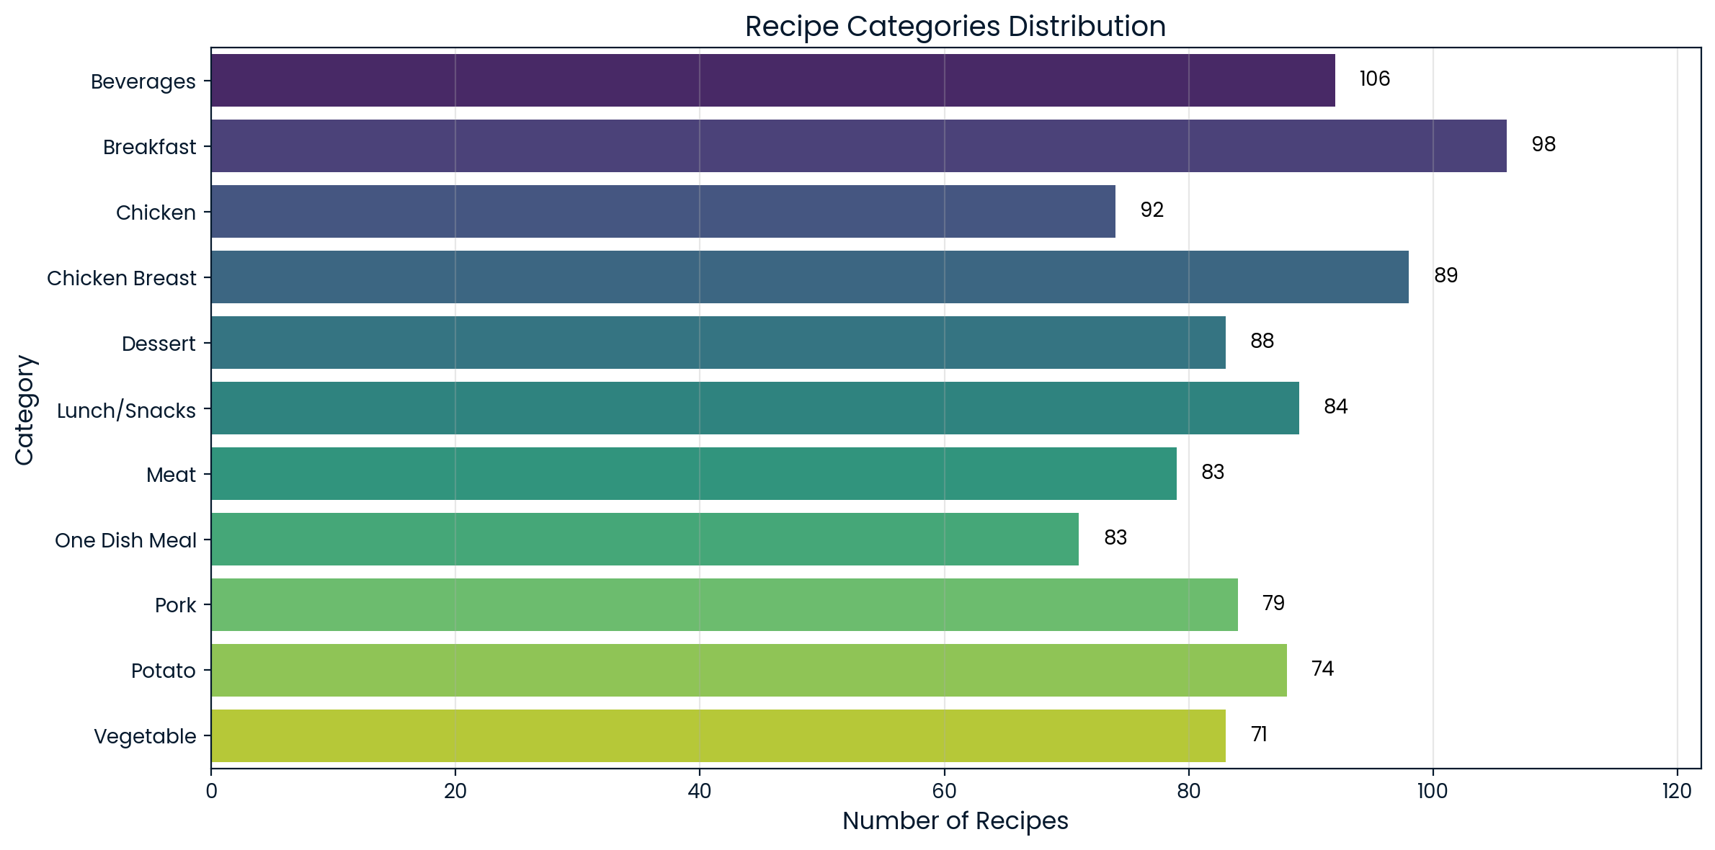
Insights
High-traffic recipes: higher median calories (350 vs. 250).
Outliers exist (e.g., 3000-calorie recipes).
Top 3: Beverages (106), Breakfast (98), Chicken (92).
High-traffic recipes skew higher in calories, but category also plays a role

Slide 5
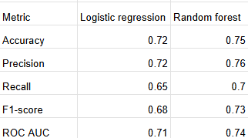
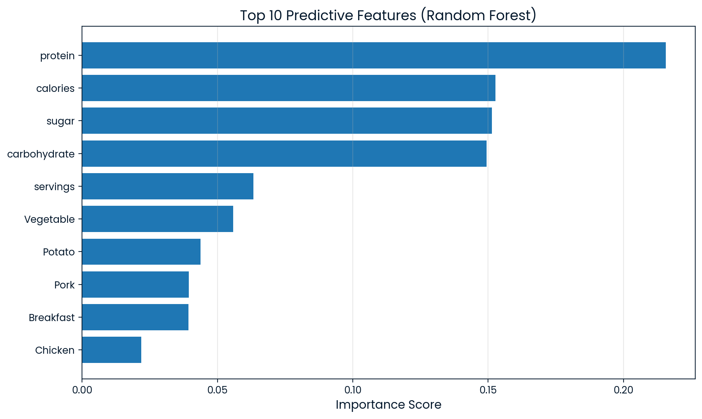
Model comparison
Random Forest outperforms Logistic Regression across all metrics, especially precision which is critical for minimizing homepage misfires
The nutritional features (calories, protein) matter more than categories. This aligns with our EDA insights about high-calorie recipes driving traffic.
Random Forest outperforms logistic regression by 4% precision

Slide 6
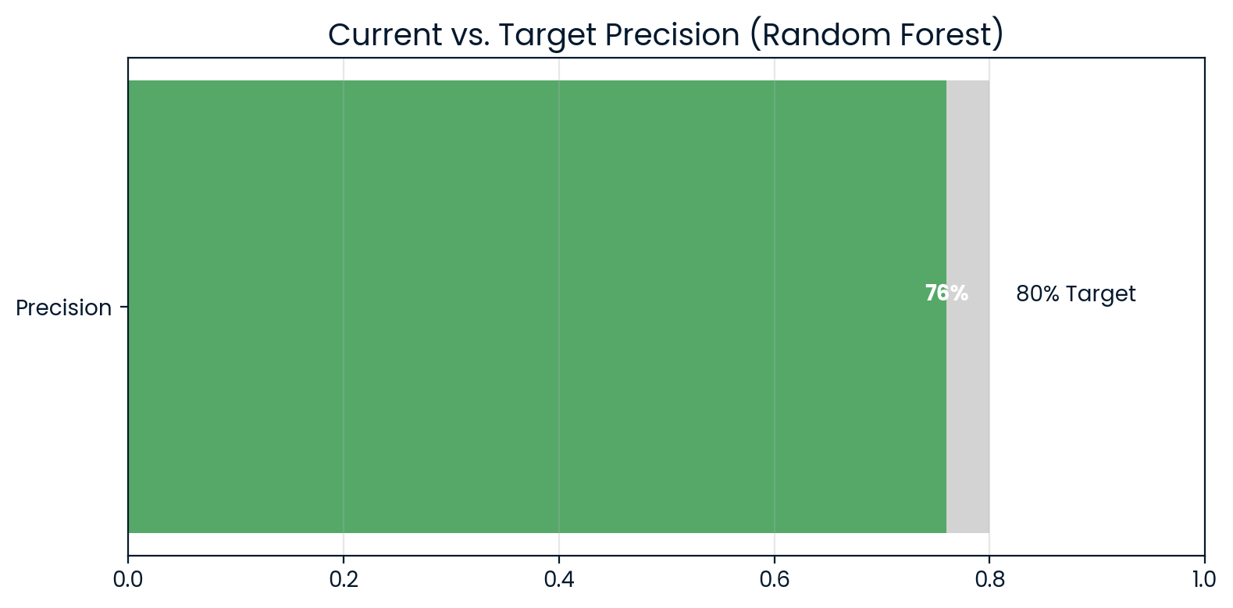
BUSINESS IMPACT
Metric to Monitor: Weekly Precision (target: 80%)
Action Plan:
A/B test model recommendations.
Alert if precision drops below 75%.
Monthly review of false positives. Data Pipeline → Model Predictions → A/B Testing
↓
Alert System
We will need to track precision weekly. If it dips, we investigate like checking for seasonal trends.

Slide 7
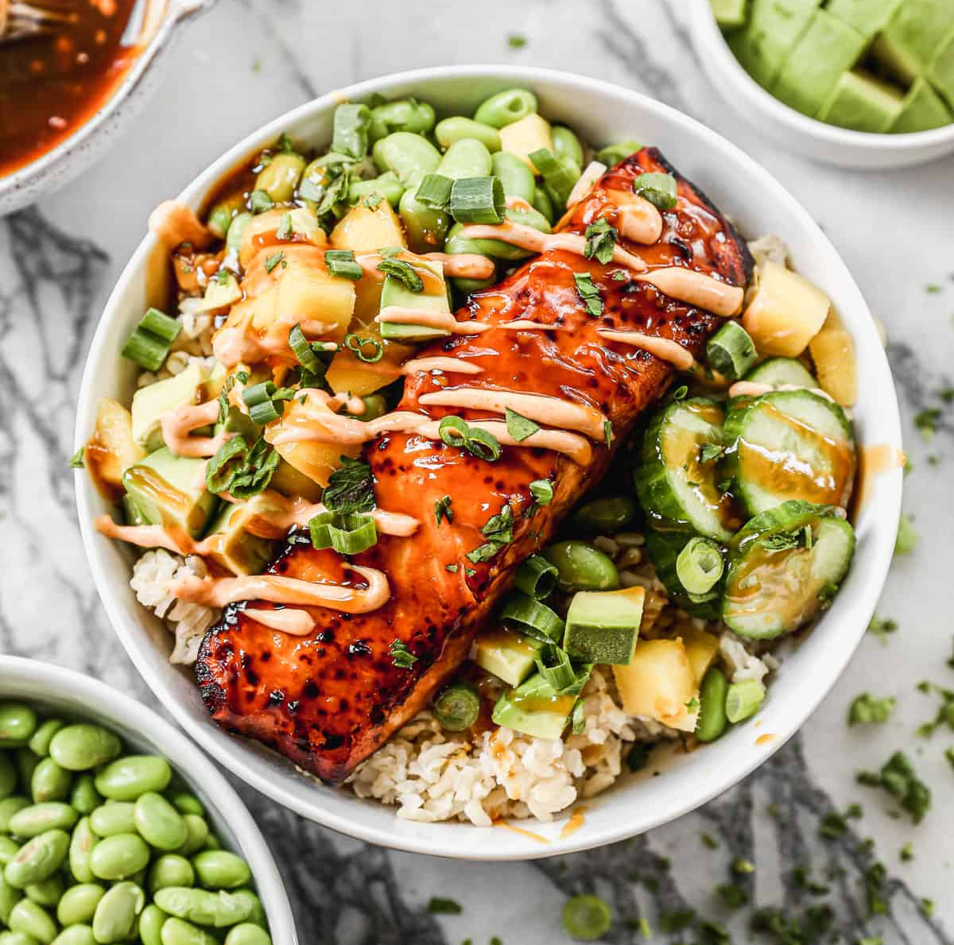

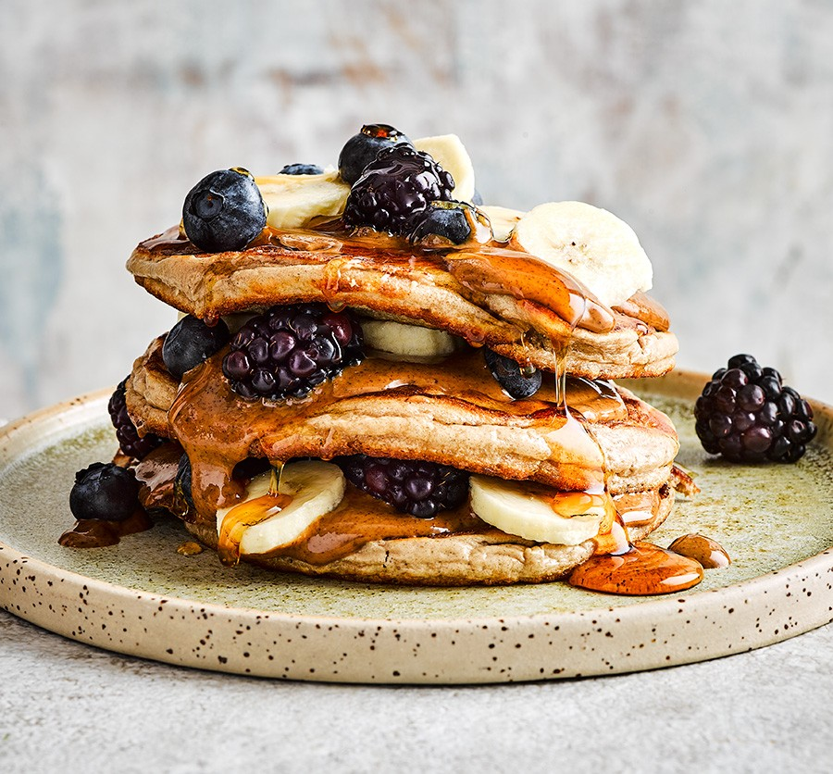
WHAT TO DO?
Launch Random Forest in staging next week.
Feature high-protein recipes (>20g/serving).
Collect new data: Cooking time, user ratings.
By focusing on protein and calories, we can immediately boost traffic while refining the model
Salmon bowl
Grilled chicken
Protein pancakes
320 cal | 28g protein
420 cal | 34g protein
380 cal | 22g protein

